Slide 1
Lezione 4 Introduction to FPGAs and Xilinx devices
Stefan Cristi Zugravel 20/01/2026

Slide 2
Early times of digital electronics

Slide 3
Why programmable ICs?
Producing a Chip costs much more than producing a PCB
Using one Chip on many PCBs increases Number of Chips and reduces Costs per Chip
If a Chip is programmable, it can be used on many PCBs in different situations
Producing one wafer costs ~ 10k€
Not included manpower to design wafer & packaging
Saving space on a PCB

Slide 4
History of Programmable Logic Devices
● 1960th
– Fuse Configurable Diode Matrix
● 1971
– Programmable ROM
● 1978
– Programmable Array Logic PAL
– Gate Array Logic GAL (reprogrammable)
– Complex Programmable Logic Device CPLD (In circuit programmable)
Configured during programming → keep configuration
● 1989
– Field Programmable Gate Array FPGA
PLA Programmable Logic Array every boolean operation fixed logic gates and programmable interconnections (matrix) OTP (one time programmable)
Development process CLPD & FPGA is almost the same

Slide 6
What are FPGAs?
Field Programmable Gate Array
Simple:
Programmable Logic Devices
More detailed:
Programmable Logic Devices
With lot of additional function-block (e.g. RAM, DSP)
Flexible configuration
Can host microcontroller

Slide 7
Kinds of FPGA

Slide 8
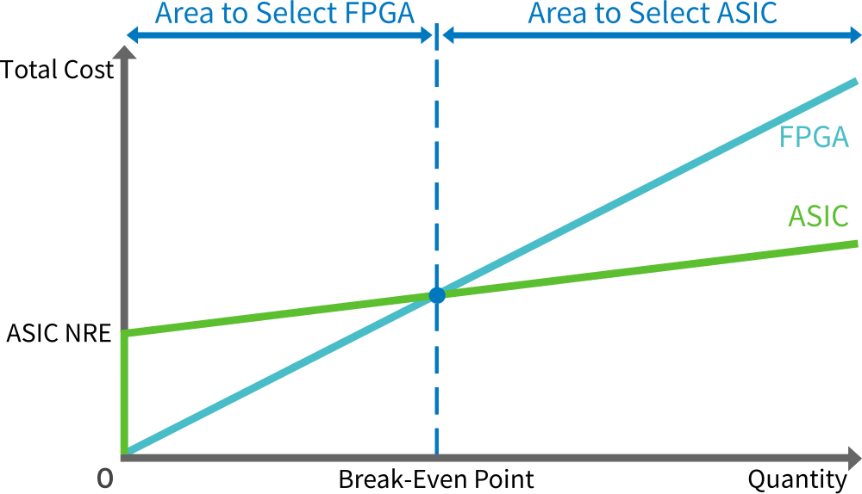
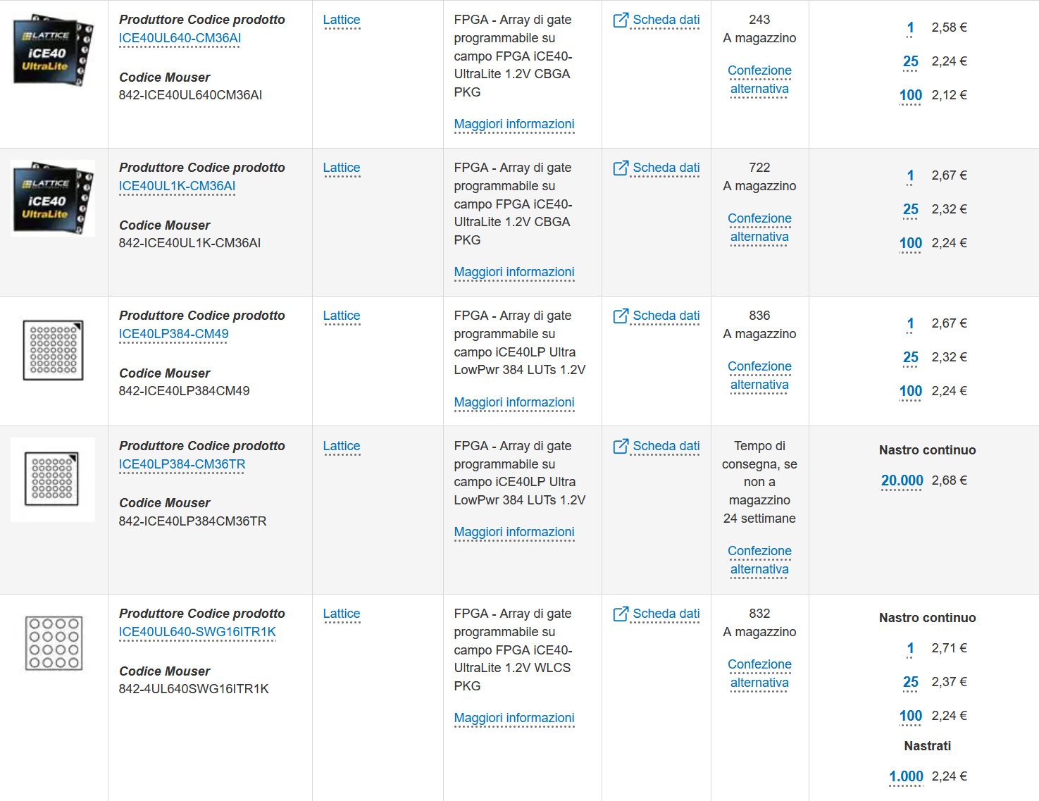
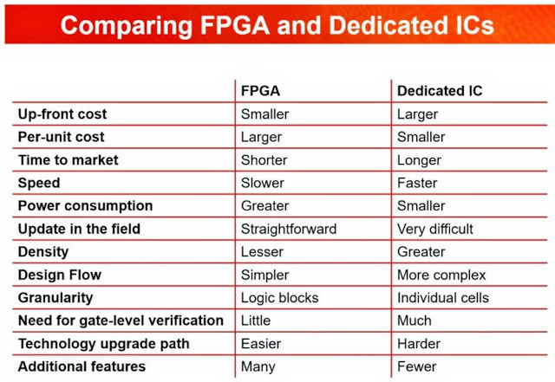
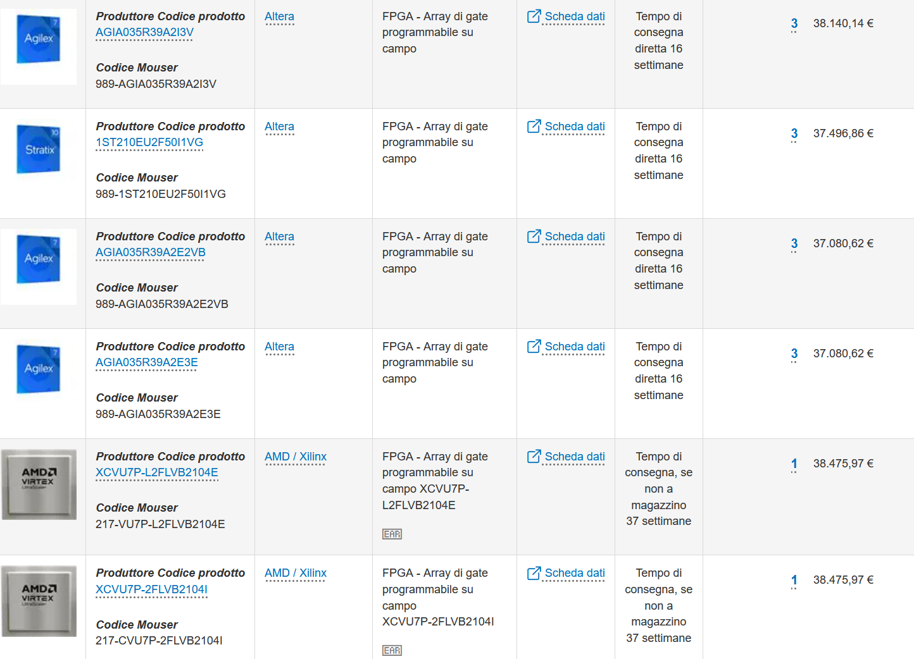
Price point

Slide 9
Fundamental FPGA components

Slide 10
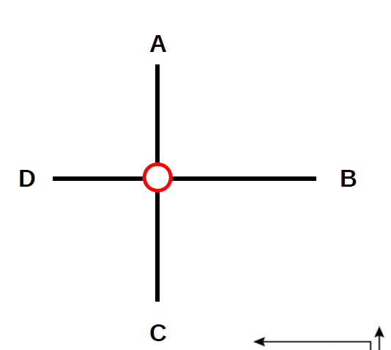
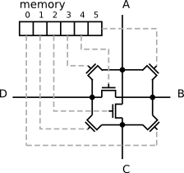
Programmable interconnections /1

Slide 11
Programmable interconnections /2
Programmable Switch Matrix

Slide 12
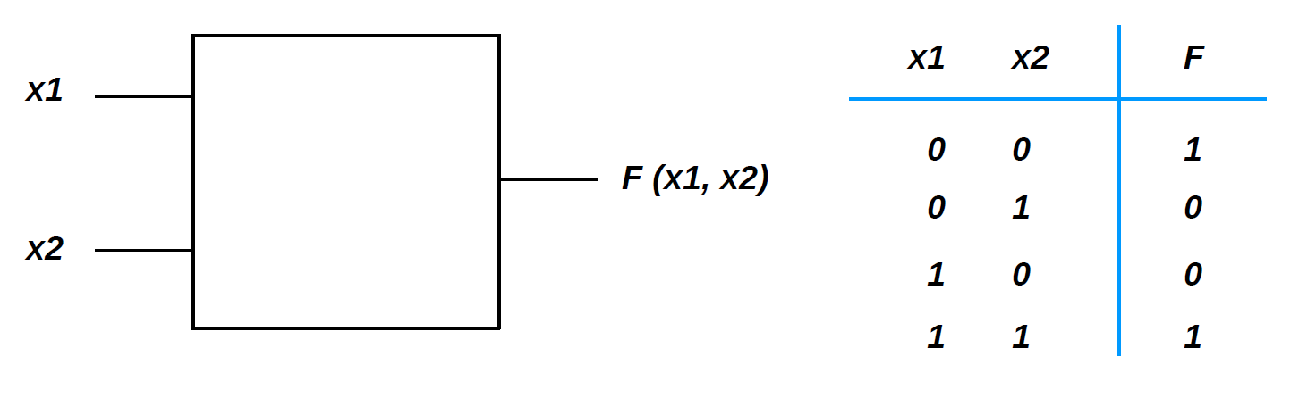
Look-up tables (LUT) /1
How to implement a 2-bit truth table (boolean logic) ?

Slide 13
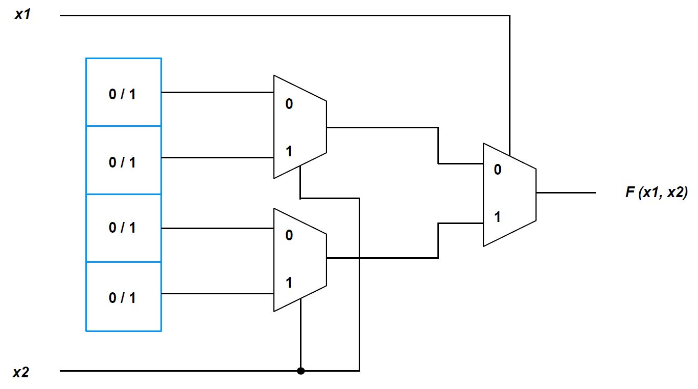
Look-up tables (LUT) /2
FPGA solution: write the truth table into a RAM !

Slide 14
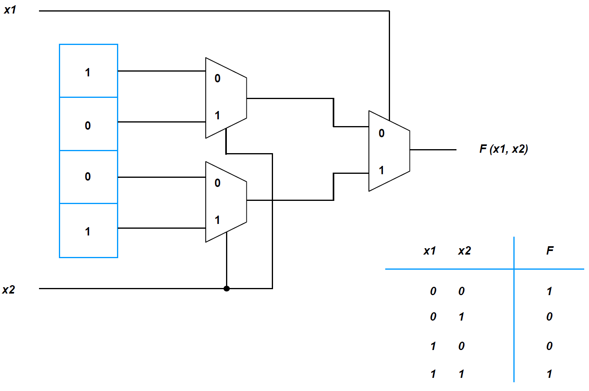
Look-up tables (LUT) /3

Slide 15
Logic Cell (LC)
Xilinx terminology :
Logic Cell (LC) = 1x LUT + 1 register (FF) + programmable MUX
LUT implemented as 6-inputs, 64-bit RAM
slice = 4x LUTs + 8 registers (FFs) + MUXs + fast-carry chain (CLA)
Congurable Logic Block (CLB) = 2x slices
Basic Element (BEL) = any device primitive
WHY?
carry-lookahead adder

Slide 16
Programmable I/O pads
I/O BLOCK
Programmable
pad

Slide 17
Xilinx 7-series family comparison
Different size, number of programmable logic cells, I/O capabilities, performance and cost depending on the chosen device family :
Spartan 7 : lowest-cost, lowest-power, good I/O performance, lowest number of resources
Artix 7 : low-power, medium number of resources and I/O, good choice for DSP
Kintex 7 : best compromise between number of resources, I/O, speed, power and cost
Virtex 7 : highest system performance (resources, speed, I/O) but also largest power consumption and highest cost

Slide 18
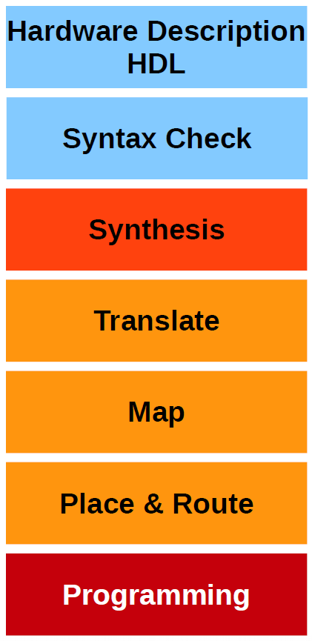
How “programming” a FPGA?
Describe what the hardware should do.
Check Syntax
“compiles” the design to transform HDL source into an architecture-specific design netlist. (connections)
Merges incoming netlists and constraints into a Xilinx design file
→ connections are merged with timing
Fits the design into the available resources
→ tell the FPGA which gate structures should be used
Places and routes the design to the timing constrains
→ decide, which gate is used for which function
Write configuration into the FPGA or configuration memory

Slide 19
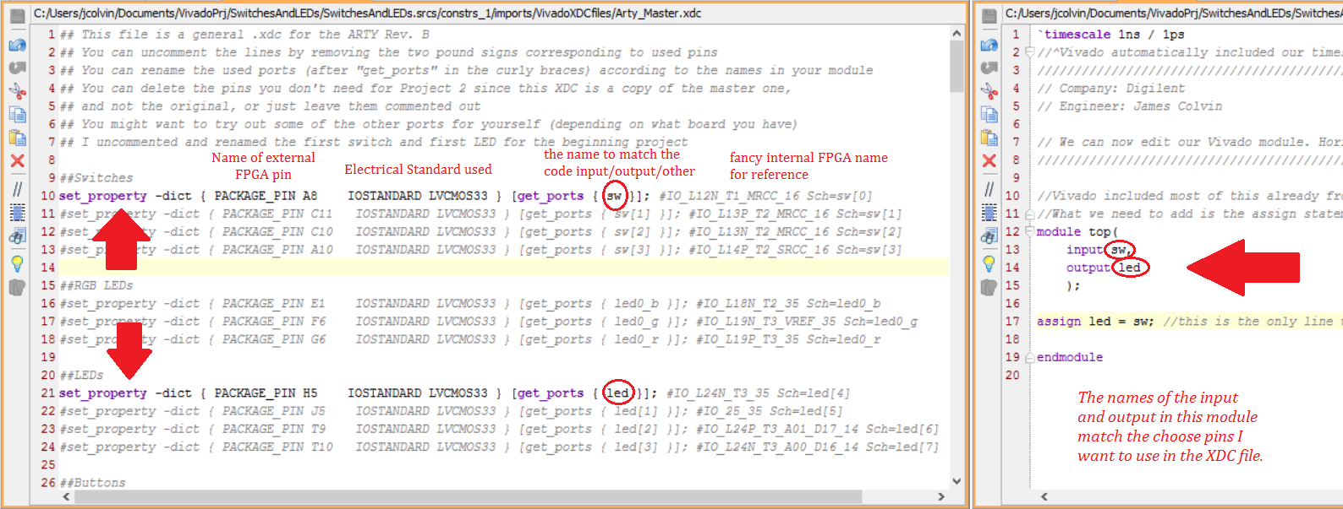
Xilinx XDC – Xilinx Design Constraints file
XDC constraints are based on the standard Synopsys Design Constraints (SDC) format. SDC has been in use and evolving for more than 20 years, making it the most popular and proven format for describing design constraints.

Slide 20
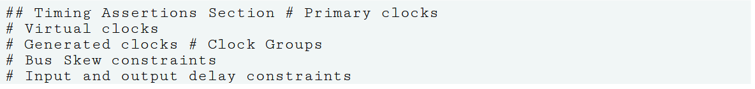
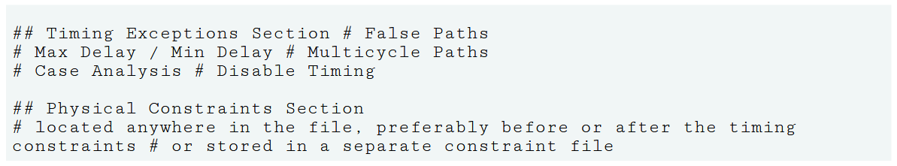
Recommended Constraints Sequence

Slide 22
Example: Digilent Arty-A7 evaluation board
Device: Xilinx Artix-7

